Slide 1
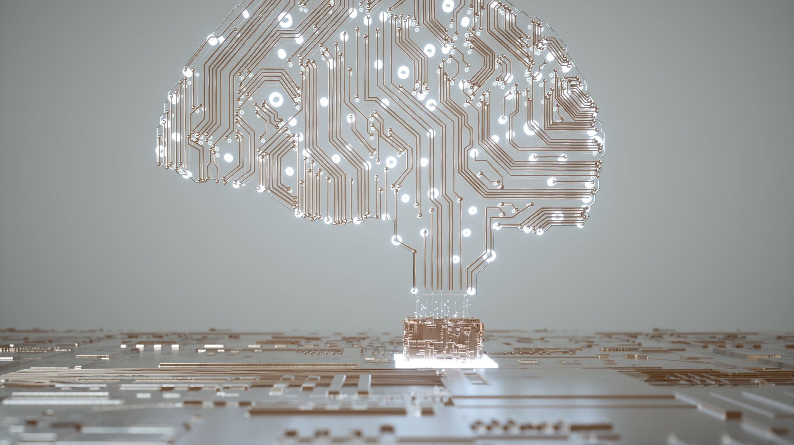
Artificial Intelligence
An introduction to AI

Slide 2
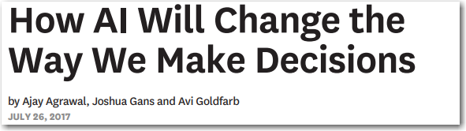
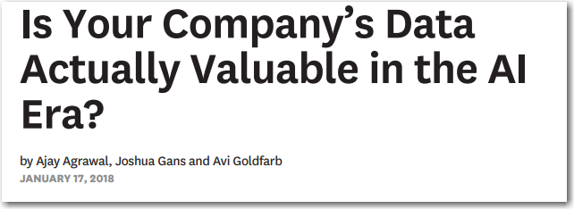

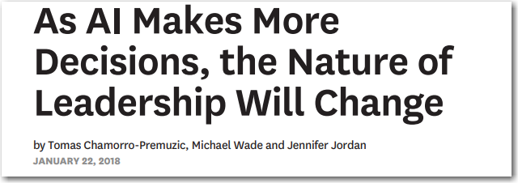
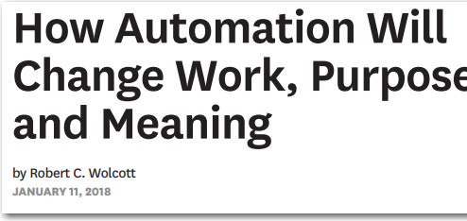
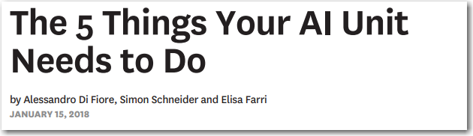
This was 2018
Notes:
Here is a small sample of the 30+ articles from Harvard Business Review on AI and machine learning … on one side AI spells doom and gloom, the other it promises everything from self-driving cars and medical breakthroughs…
A lot has been made of a computer beating the worlds best players at Go and Chess. Does anyone here play Go? Its complexity is masked in its simplicity.
But how do you separate hype from reality? How can your company apply AI and Machine Learning to solve real business problems in 2018?
I want to leave you with a few thoughts…
AI / ML / Advanced Analytics are table stakes when it comes to fighting financial crimes
It’s the system that’s important not algorithms
Automation Accuracy and Adaptability the 3A’s of AI – is the key
ALIAS is the answer eliminating 80% of the manual part of the process. Automatio, Accuracy and Adaptiablility
Because the barriers to entry – education, examples usage of algorithms, data and cloud computing have made AI & ML more accessible
We’ve created a playground for the Data Scientists
And like many creative people there is backlash against procedure, process and productivity.
It’s the System that’s important
AI is about It’s all about productivity & improvemenet
How far up and down the value chain can we apply
Its this idea of productivity
There is a proliferation of tools, approaches, platforms, algorithms, data mgmt. approaches, etc… it’s a playground for Data Scientists
The juice is worth the squeeze
You can do this today
Peel back the lid on the Black-box

Slide 3
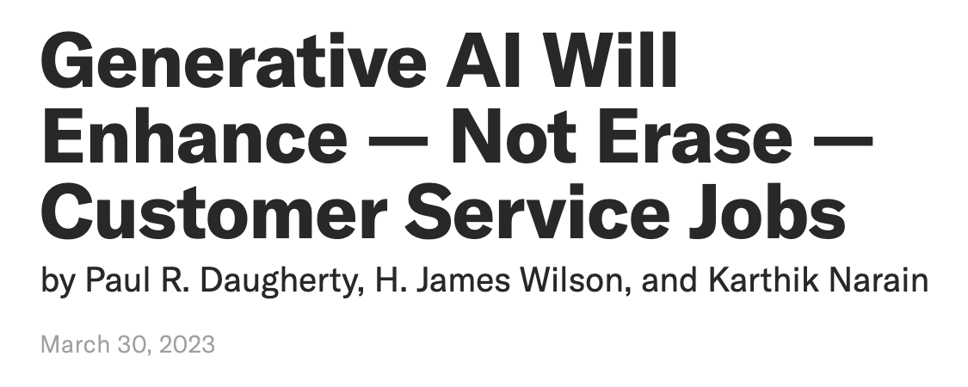
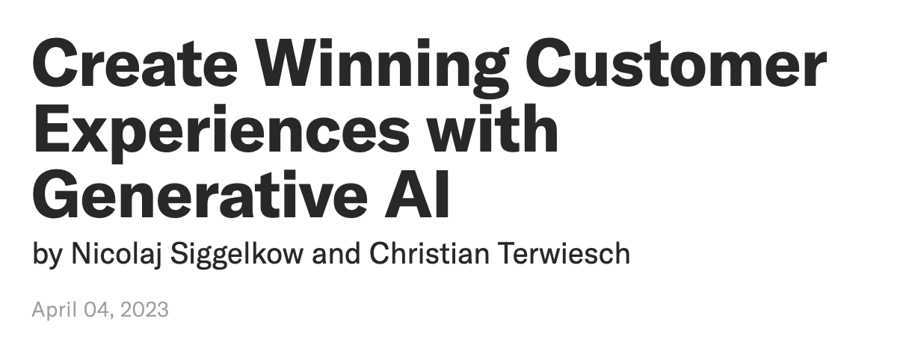
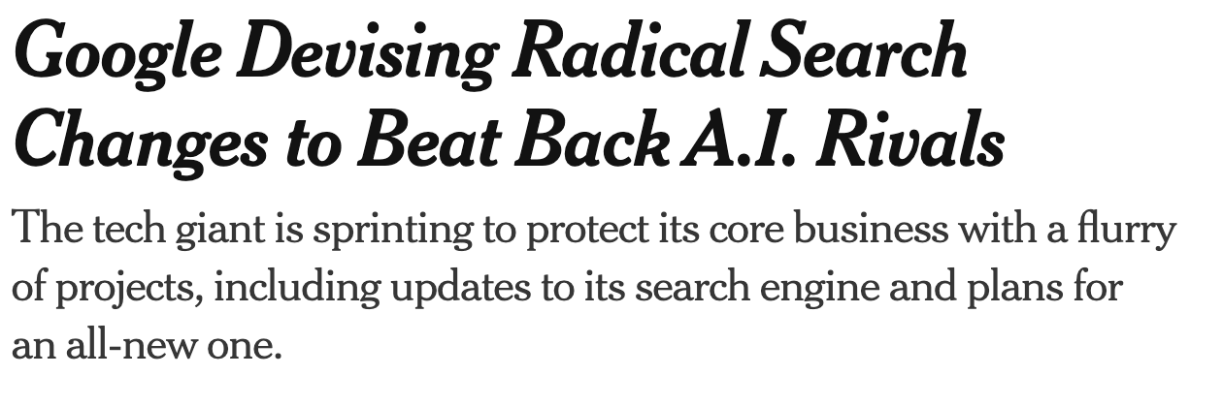
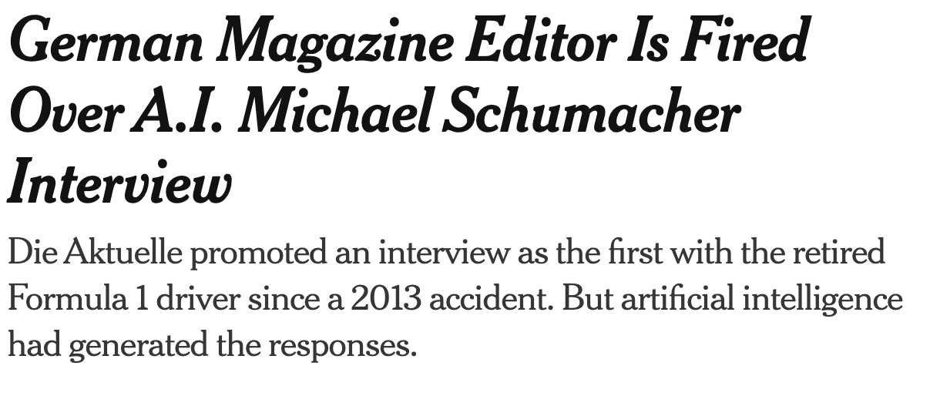
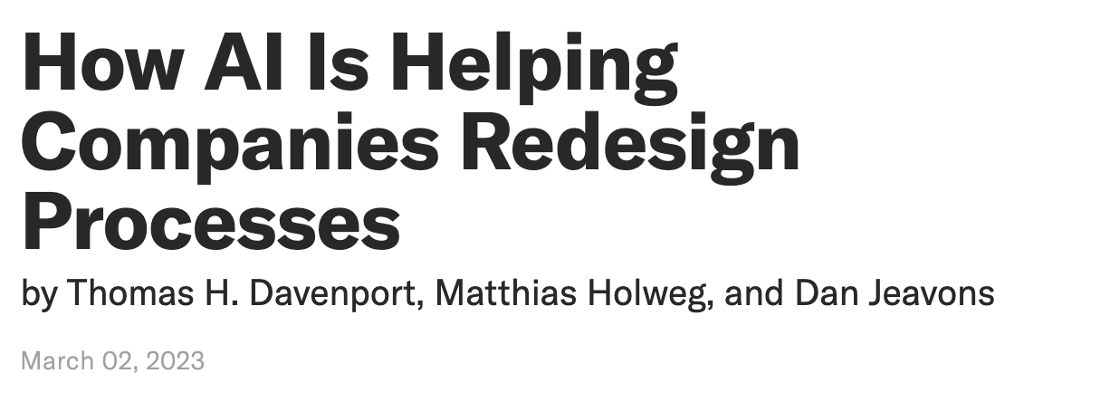
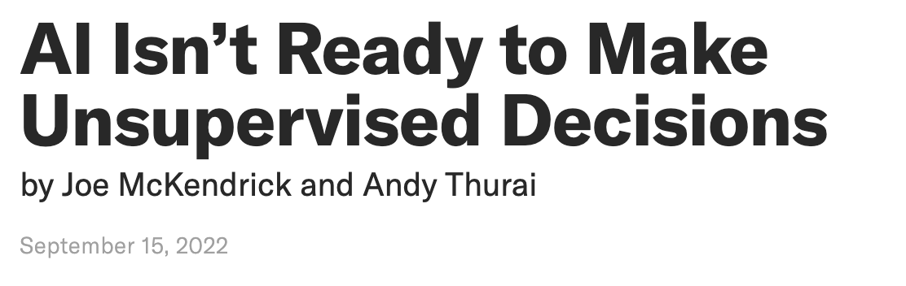
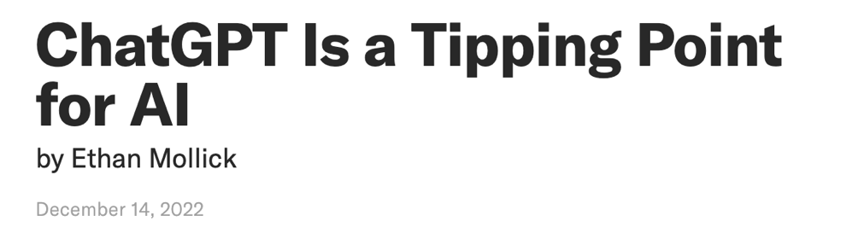
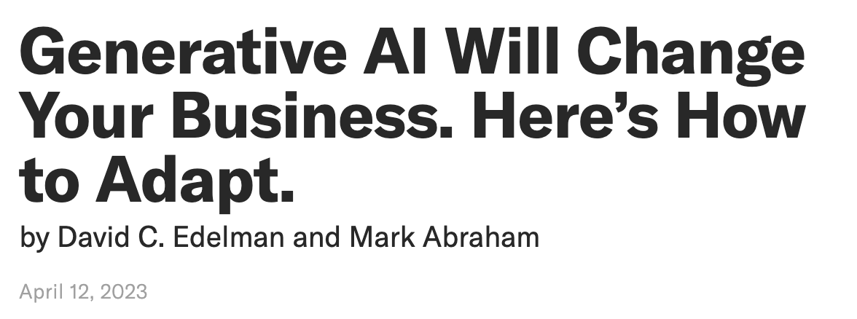
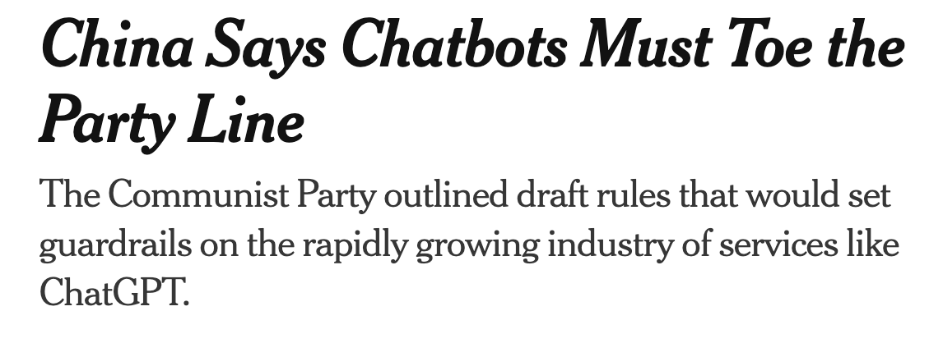
Notes:
The new chatbots may well pass the Turing test, named for the British mathematician Alan Turing, who once suggested that a machine might be said to “think” if a human could not tell its responses from those of another human.

Slide 4
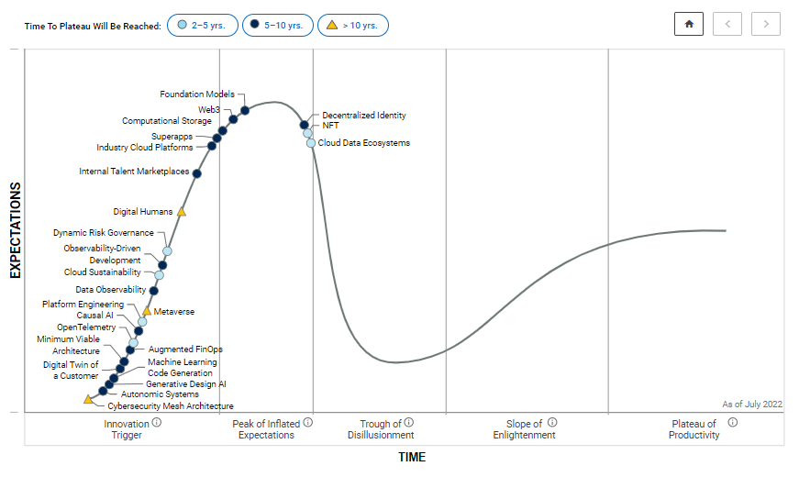
Hype cycle

Slide 5
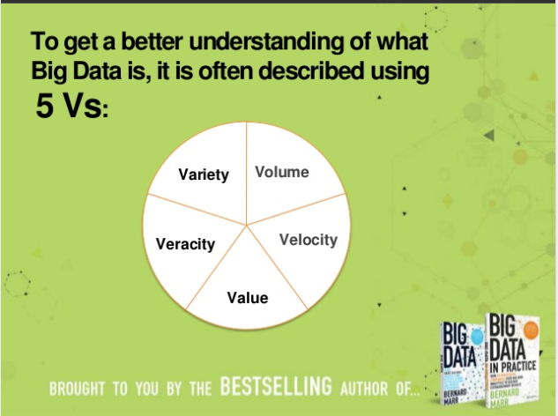
3,4,5,7 or 9 Vs of Big Data
Or just 5 Vs
Volume – the vast amounts of data our systems pump out every second, it adds up.
Variety – the different types of data we have access to, structured, unstructured, semi-structured, voice, text, image, video etc. it’s a lot.
Velocity – the speed at which data is created.
Veracity – the messiness or trustworthiness of data.
Value – which leads us to Analytics – how do create value from data?
Notes:
We’ve all seen these trends come and go… 8 years ago it was big data and Hadoop today it’s AI – like any trend we have peel back the onion to see what's really going on….
the real story about Big Data hype parts in my opinion can be divided into two themes:
First business woke up the potential of leveraging their data with analytics, we saw explosive growth in the interest in Data Processing, and Business Intelligence and now we’ve seen that with advanced analytics, machine learning and AI
Second was the cost of storage and computing nose dived giving rise to Cloud computing … I mean i just bought a 2 TB $50 the other day…

Slide 6
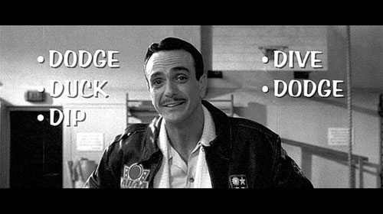
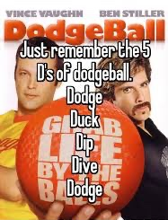
What about …
The 5 D’s of Dodgeball?
Dodge, Duck, Dip, Dive and Dodge
Notes:
So while I joke about the 3 V’s of big data – it was a great catch-phrase that we could latch onto, just like the 5 D’s of dodgeball. So I’ve come up with my own catch phrase….

Slide 7
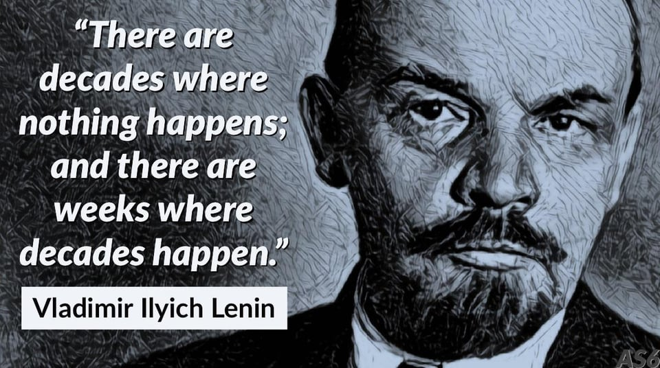
Generative AI has caught people’s attention
How long to 1M users?
Netflix – 3.5 years
Airbnb – 2.5 years
Facebook – 10 months
Spotify – 5 months
Instagram – 74 days
ChatGPT – 5 days
Notes:
See TKspeaks

Slide 8
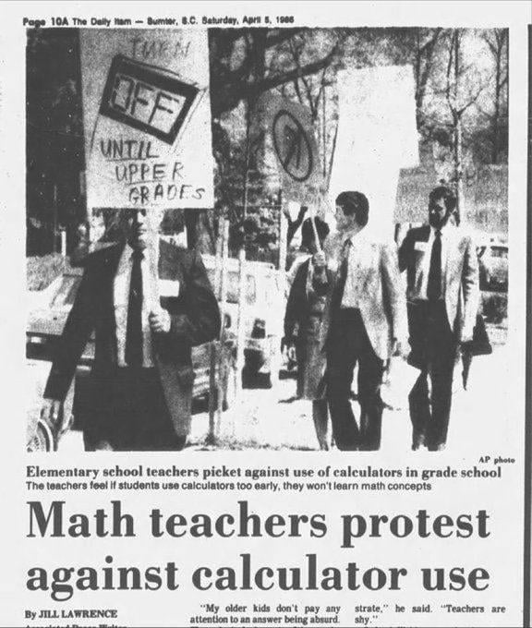
Notes:
Hindsight

Slide 9
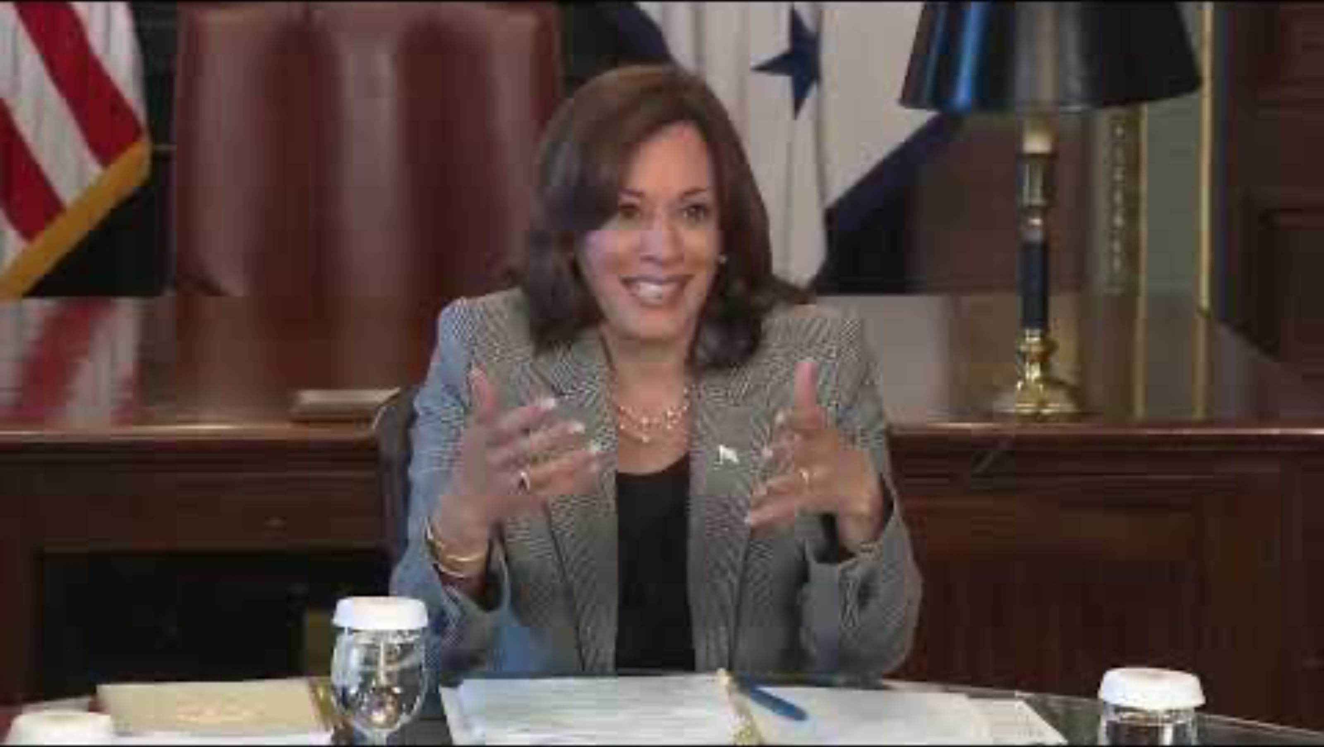
What is AI?

Slide 10
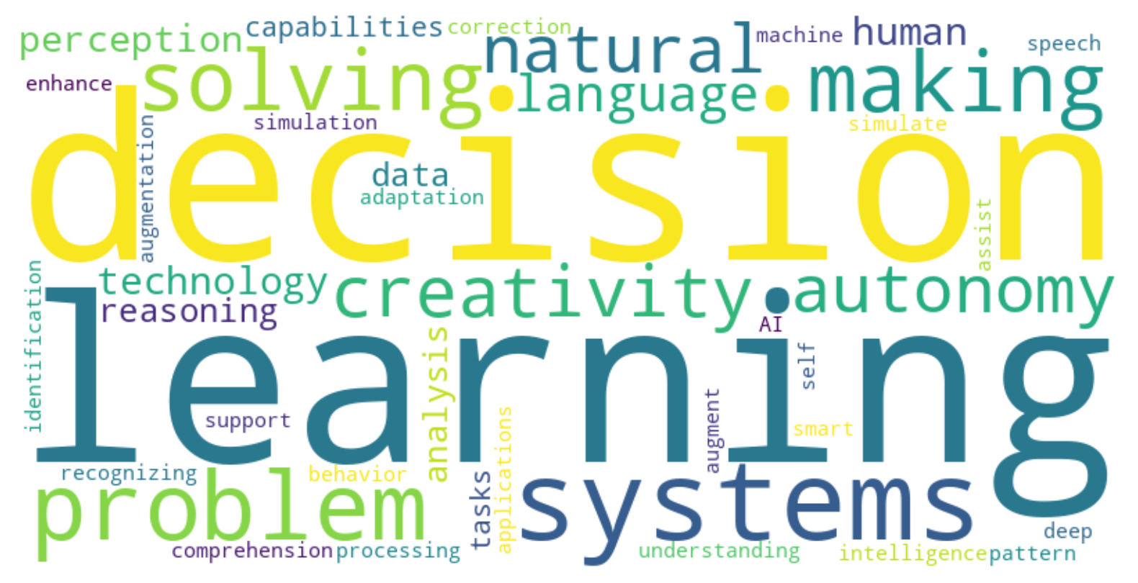
Maybe we’ll ask the experts…
Amazon “AI is the technology that enables computers and machines to simulate human learning, comprehension, problem-solving, decision-making, creativity, and autonomy. AI applications can see and identify objects, understand and respond to human language, learn from new information and experiences, and act independently.”
IBM “AI is the development of computer systems capable of performing tasks that historically required human intelligence, such as recognizing speech, making decisions, and identifying patterns. AI encompasses a wide variety of technologies, including machine learning, deep learning, and natural language processing.”
Google “AI is the science of making things smart, enabling computers to perform tasks that typically require human intelligence. This includes understanding natural language, recognizing patterns, and making decisions. Google's AI research focuses on developing systems that can learn and adapt over time.”
Microsoft “AI is the capability of a machine to imitate intelligent human behavior. Their AI research aims to create systems that can perceive, learn, reason, and assist in decision-making to augment human capabilities.”
Experian “AI is the simulation of human intelligence processes by machines, especially computer systems. These processes include learning, reasoning, and self-correction. Experian utilizes AI to enhance data analysis and decision-making processes.”
Notes:
Well 3 experts, one has been and one competitor… so

Slide 11

What is AI?
"Artificial Intelligence (AI) simulates human-like behavior and decision-making through automated processes. It enables computer programs to mimic human interactions and cognitive functions, enhancing productivity, efficiency, and accuracy across various tasks.”
Simulates Human-like behavior and decision-making beyond simple automation
Process automation is at the core of the functionality
Designed to enhance productivity, efficiency, and accuracy
Notes:
.

Slide 12

WHAT IS MACHINE LEARNING?
Statistics quantifies numbers
Describes data (mean, median, mode, standard deviation etc.)
Draws conclusions from data (hypothesis test, deriving estimates etc.)
Machine Learning predicts with models
Process of fitting models to data with the goal of predictive accuracy
“Deep Learning” is a specific class of machine learning models
Artificial Intelligence provides the appearance of behavior through automation
Computer programs to mimic “human” behavior and interactions
Automate processes for productivity, efficiency and accuracy
Data Mining & Data Science finds patterns to explain a phenomenon
Practical application of computer programs, Statistics and Machine Learning
Notes:
You’ll also hear about statistics and artificial intelligence, data mining and data science – here is my take… and let me say this is one person’s opinion don’t’ start sending me hate mail…
there is no “evaluation” or way to measure the accuracy of the algorithm – then you don’t have ML and AI
Statistics is about describing distributions, and inferring relationships, testing hypothesis, deriving estimates, , and quantifying the data. – statistics is a science,
a discipline where data mining, ml and ai are an amalgam of statistics and computer science.
Statistical models are about description and inference not necessarily about predictive accuracy – problems like speech recognition, image recognition, handwriting recognition are tough to accurately do with statistical techniques alone. However, statistical models are really useful in evaluating the effectiveness of a machine learning system.
Data Mining is about using statistics and other methods to find patterns hidden in the data so that you can explain some phenomenon.
Machine Learning uses Data Mining techniques and other learning algorithms to build models of what is happening behind some data so that it can predict future outcomes. Math is the basis for many of the algorithms, but this is more towards programming.
Artificial Intelligence uses many models built by Machine Learning and other ways to reason about the world and give rise to intelligent behavior or behavior that mimics behavioral human or other interaction whether this is playing a game or driving a robot/car. Artificial Intelligence has some goal to achieve by predicting how actions will affect the model of the world and chooses the actions that will best achieve that goal. Very programming based.
Anyway, the statisticians, mathematicians, and scientists out there will probably take issue with my descriptions – you can send hate mail
Machine Learning has 4 basic ingredients – to be considered Machine Learning or Computer Learning
Train an algorithm to recognize some pattern
Evaluate the “accuracy” of the algorithm
Apply of the algorithm on new and unseen data within a system
Learn from outcomes of the algorithm on new and unseen data – repeating steps 1 – 3
You can use this to evaluate reality from the hype…
If there is no “algorithm” there is no “machine”, an algorithm can be as simple as IF this THEN that.
If there is no evaluation then you just have a computer program
If you can’t apply it to new data you’ve just made a execute once computer program –
If you can’t learn and improve from the outcomes you just have a computer program

Slide 13

Evolution
Artificial Intelligence
Artificial Intelligence
Machine Learning
Deep Learning
Neural Network
Classical
Data Size , Variety & Compute Power
Modern
1950s
1980s
2010’s
Present
Past to Present
Notes:
Machine learning was known as artificial intelligence in the 1950s. – it evolved from the “Turing” test, a test that measures machine intelligence – basically the Turing Test is to “build a computer that can sufficiently imitate a human to the point where a suspicious judge cannot tell the difference between human and machine.” and seems like we still are learning nearly 70 years later that its much more complicated to imitate human behavior than initially thought.
That’s not to say that in the 1980s there were massive advances in computing technology, In the 80’s computing technology let us train neural networks more effectively, and advanced areas like decision trees and there was an explosion in robotics – where instead of modeling machine learning based on how humans behave, they took a look at how we could mimic the behavior of insects – you know avoid obstacles, do simple things like pick up cans off of desks. – Rodney Brooks’s work on robotics at MIT led to the Roomba ! The first commercial autonomous vacuum cleaner.
Fast forward to 2010 advances in computing – we had things like the Xbox Kinect 360 where a camera can track a user’s motion; IBM’s Watson defeated a Jeopardy champion, etc. – but the big news was advances in neural networks – specifically what are called deep learning neural networks – previously it was computationally infeasible to train “deep” multi-layer networks. This advancement enabled computers to identify objects better than humans. It turns out that deep learning is also really good at text and language – and they’ve been used for text generation, speech recognition, image recognition and of course computer games.
Today we are at the cusp of another inflection point with AI and Cognitive Computing, this is where through the use of multiple machine learning techniques we can start to mimic “human” behaviors – at Georgia Tech for example created Jill Watson – a virtual Teaching Assistant for their online master’s computer science Artificial Intelligence Class – most recently knowing that one of 15 teaching assistants was a computer only 50% of the class was able to correctly identify the computerized TA – that’s pretty amazing. Today and probably for the next couple years you’ll see these intelligent assistants be deployed as front line automated support for everything from the your cellular company, cable company, banks and insurance and more – and instead of the annoying cycle of “can you hear me now "questions we get today you’ll be speaking to a digital assistant and won’t even know it.
Anywhere there is a large database of common questions and answers is low hanging fruit for intelligent assistants.

Slide 14
Why Now?… a little history
1950s – Early Foundations of AI
1956: Dartmouth Conference – AI as a formal field of study.
1958: Perceptron – Introduction of learning from data in neural networks.
1980s – Revival of Neural Networks
1986: Backpropagation Algorithm (Geoffrey Hinton) – Allowed neural networks to learn complex patterns, establishing the foundation for deep learning.
2000s – Early Deep Learning Advances
1998: Convolutional Neural Networks (CNNs) CNNs laid the groundwork for modern computer vision applications.
2006: Deep Belief Networks (Geoffrey Hinton) – Demonstrated feasibility of deeper networks, sparking renewed interest in deep learning.
2009: Big Data Era – Growth in digital data provided essential resources for training advanced AI models.

Slide 15
Why Now? … recent advances
2010s – Breakthroughs in AI Applications
2012: ImageNet Competition (AlexNet by Hinton’s team) – Achieved significant image recognition advances, marking deep learning’s breakthrough.
2014: (GANs) – New capabilities in creative applications. Generative Adversarial Networks – Allowed neural networks to GENERATE.
2016: AlphaGo – Milestone in strategic AI, defeating a Go champion.
2017: “Attention is all you Need” Transformers and Self-Attention
2018: BERT – Revolutionized natural language processing.
2020s – AI enters Everyday Life
2020: GPT-3 – Transformational text generation, bringing AI to content creation.
2022-2023: Generative AI Boom – Mainstream adoption of generative AI with tools like ChatGPT.
Present Day: Widespread AI Integration

Slide 16
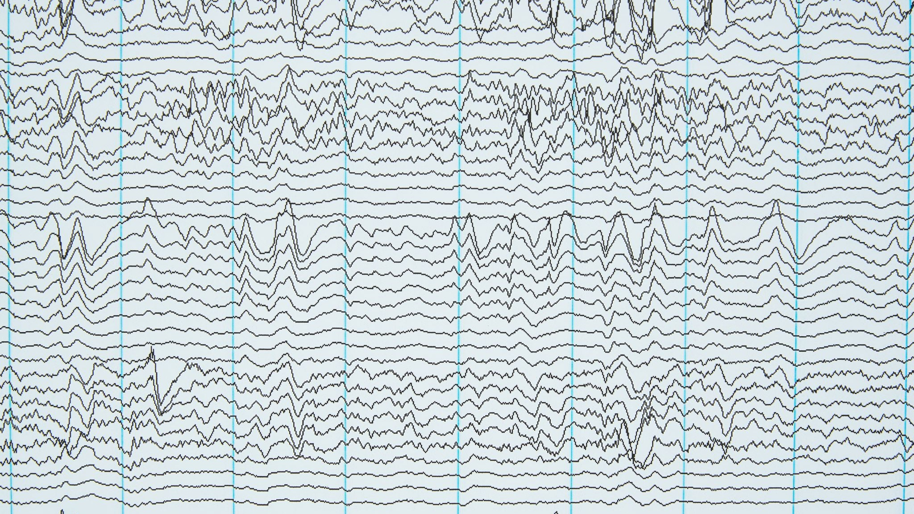
History..
1956: Dartmouth Conference – Formalized AI as a field.
1958: Perceptron – Early neural network model.
1986: Backpropagation (Hinton) – Enabled learning in neural networks.
1997: LSTM Networks – Key for sequence data and "type-ahead" features.
1998: Convolutional Neural Networks (CNNs) – Essential for computer vision.
2006: Deep Belief Networks (Hinton) – Sparked renewed interest in deep learning.
2009: Big Data Era – Enabled large-scale training for AI models.
2012: ImageNet (AlexNet) – Breakthrough in image recognition.
2014: GANs (Goodfellow) and Attention Mechanisms = Creative AI
2016: AlphaGo – Strategic AI breakthrough.
2017: Transformers and Self-Attention – Revolutionized NLP.
2018: BERT – Advanced NLP with transformer-based models.
2020: GPT-3 – Transformational in text generation.
2021: AI in Drug Discovery – Supported rapid COVID-19 response.
2022-2023: Generative AI boom (e.g., ChatGPT) – Mainstream AI adoption.

Slide 17
Why Now? And then there is the cost, storage and memory components …
1960s – Early Mainframes
1970s – Minicomputers and Moore's Law
1980s – Personal Computers (PCs)
1990s – The Internet Boom and Commodity Hardware
2000s – Cloud Computing and Virtualization
2010s – GPUs and Specialized Hardware for AI
2020s – Edge Computing and Continued Cost Reduction
Today – Specialized Hardware Mainstream
Computationally Infeasible
AND It’s still TOO SLOW and TOO EXPENSIVE for many applications

Slide 18
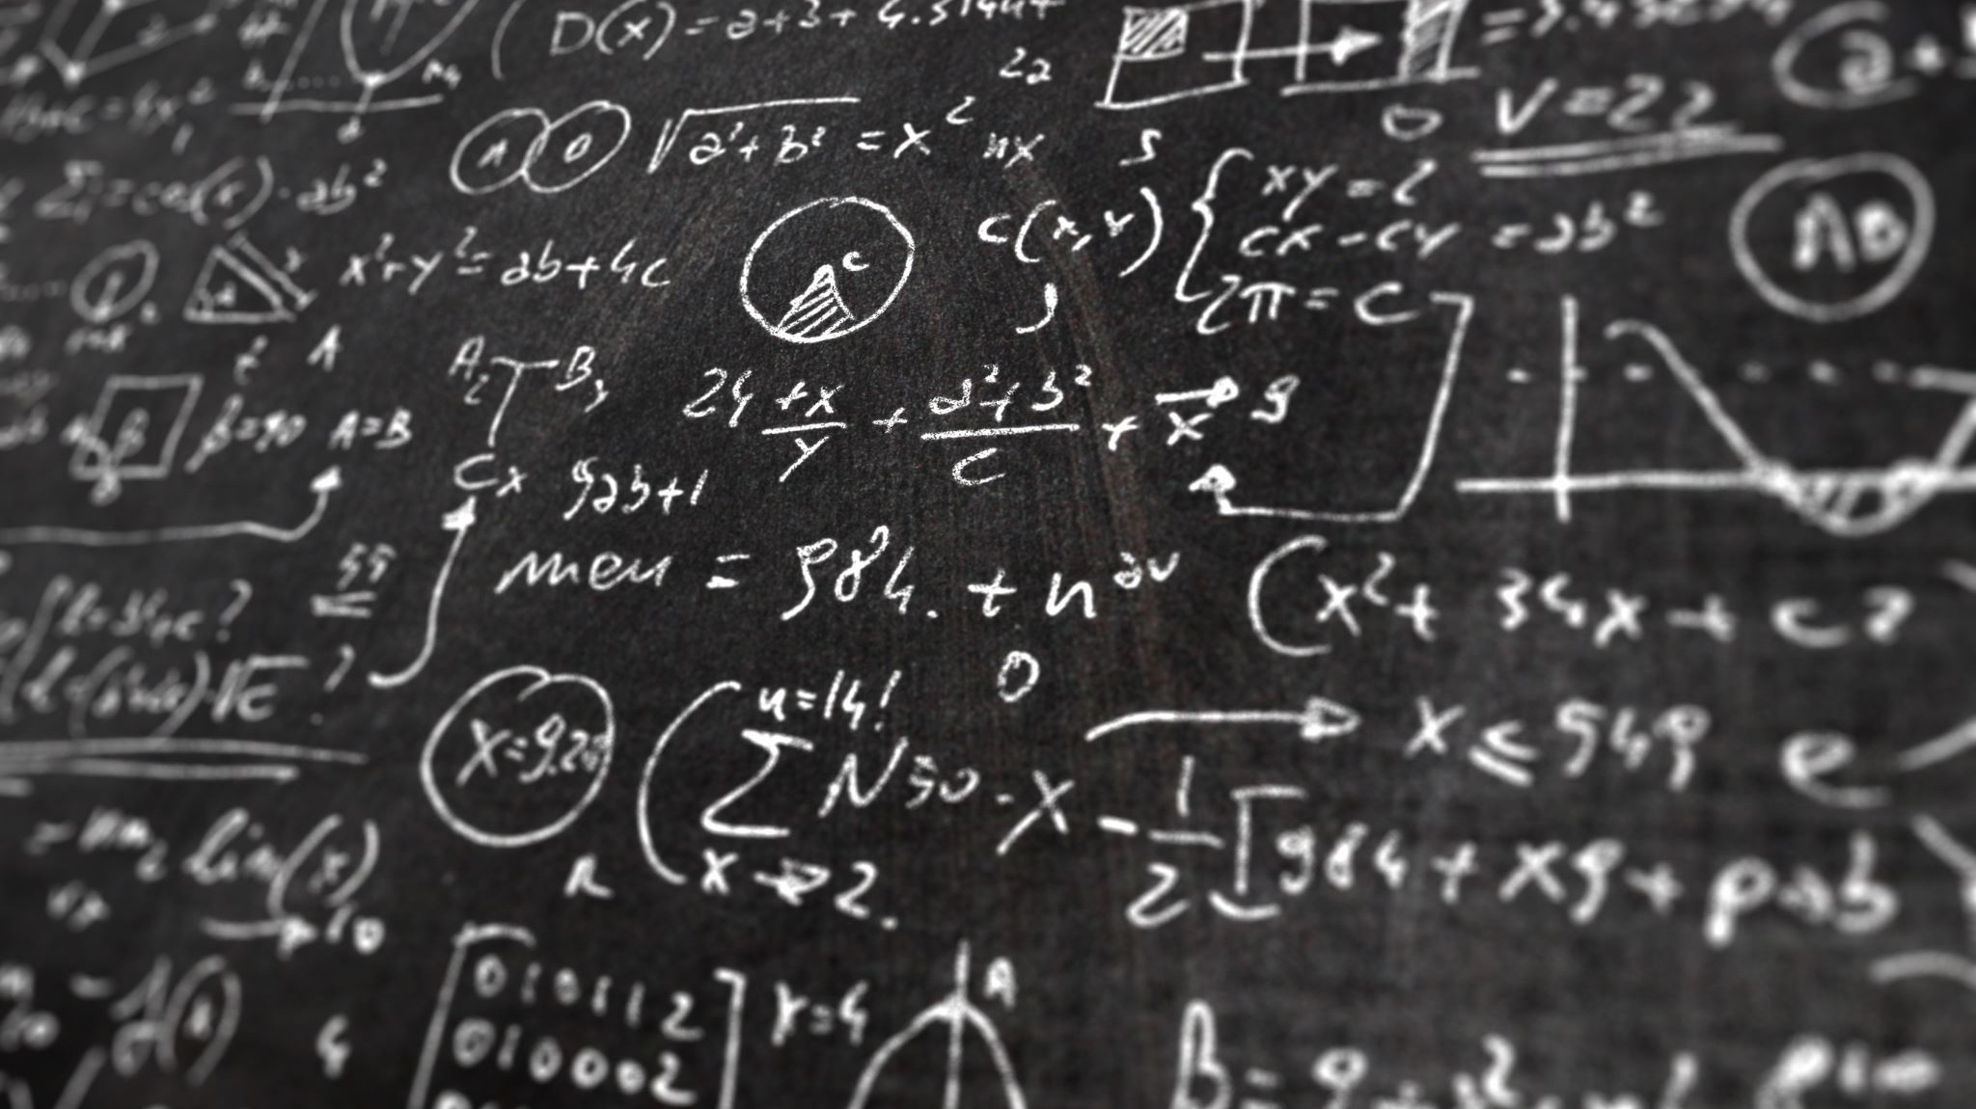
But what is it… Neural Networks
Big’Ol formulas

Slide 19
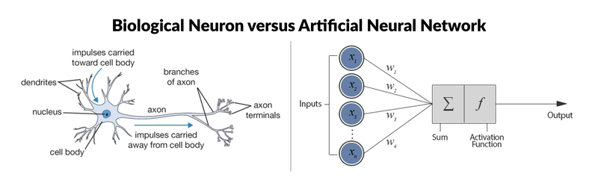
The Classic Diagram
A neural network is a type of machine learning model which models itself after the human brain, creating an artificial neural network that via an algorithm allows the computer to learn by incorporating new data.

Slide 20

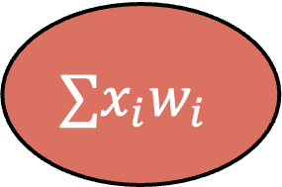

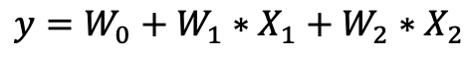
Neural Network: Linear Regression
A Neural network is nothing more than a big-ol-formula
Activation function
X0 = 1
W0
$$∑x_{i}w_{i}$$
W1
$$∅$$
$$y=W_{0}+W_{1}∗X_{1}+W_{2}∗X_{2}$$
X1
W2
SUM & Activate
X2
Activation Function
$$f_{x}=x$$
Inputs
Weights
Output
$$price=1∗w_{0}+Age ∗w_{1}+ …Heated_{Area}∗w_{i}$$
intercept

Slide 21
Demystifying Neural Networks ~ house price example
Let’s predict house price…
Inputs – Characteristics of a house (e.g., square footage, number of rooms)
Weights – Reflect how important each feature is for the house price, basically dollar per characteristic measure
Bias – An adjustment value that helps improve accuracy.
Output – The predicted price.
$HousePrice=SquareFeet ∗\$perSquareFeet+AgeOfHouse ∗\$perYear$ + NumberOfRooms * $\$perRoom+Bias…$
𝐻𝑜𝑢𝑠𝑒𝑃𝑟𝑖𝑐𝑒=𝑆𝑞𝑢𝑎𝑟𝑒𝐹𝑒𝑒𝑡 ∗$𝒑𝒆𝒓𝑺𝒒𝒖𝒂𝒓𝒆𝑭𝒆𝒆𝒕+𝐴𝑔𝑒𝑂𝑓𝐻𝑜𝑢𝑠𝑒 ∗$𝒑𝒆𝒓𝒀𝒆𝒂𝒓 + NumberOfRooms * $𝒑𝒆𝒓𝑹𝒐𝒐𝒎+𝐵𝑖𝑎𝑠…

Slide 22

Geoffrey Hinton ‘The Godfather of AI’
“I’ve come to the conclusion that the kind of intelligence we’re developing is very different from the intelligence we have,” he said. “So it’s as if you had 10,000 people and whenever one person learned something, everybody automatically knew it. And that’s how these chatbots can know so much more than any one person.” – G. Hinton
Notes:
2006 - Geoffrey Hinton published “A Fast-Learning Algorithm for Deep Belief Nets (DBN)”.
This work is credited the foundational moments that led to the current "deep learning revolution
The breakthrough of Hinton and his colleagues' work was in introducing an efficient training method for DBNs.
development of more sophisticated deep learning models and techniques that have since revolutionized the ability of computers to learn from and interpret data.

Slide 23
How AI is Different from Machine Learning
AI: A broad field aiming to create machines capable of mimicking human intelligence.
ML: A subset of AI focusing on algorithms that learn patterns from data, improving without direct programming.

Slide 24
The key-difference between AI and ML is Generation…
AI = Generation:
The ability to create or "generate" new content (Text, Image, Sound etc.) sets AI apart and aligns with its goal to mimic aspects of human intelligence and creativity.
ML = Prediction:
Predicting stock prices, diagnosing diseases, or recommending products. ML algorithms predictions based on data. That prediction an be something as simple as what comes next…

Slide 25
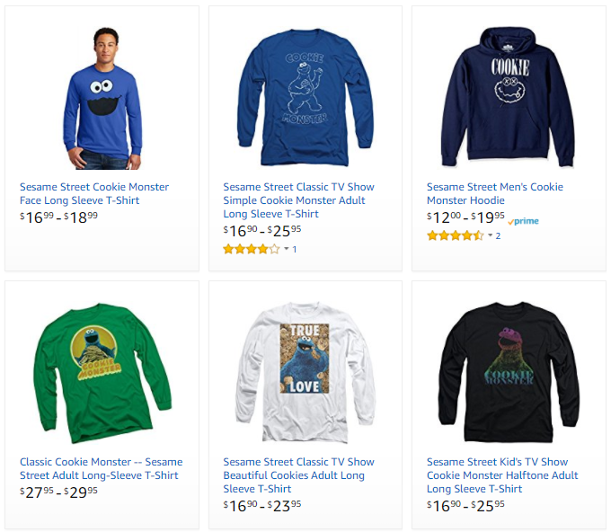
Classic Machine Learning Algorithms
Business/ML Problem
Description
Example
Ranking
Helping users find the most relevant thing
Ranking algorithm within Amazon Search
Recommendation
Giving users the thing they may be most interested in
Classification
Figuring out what kind of thing something is
Regression
Predicting a numerical value of a thing
Clustering
Putting similar things together
Anomaly Detection
Finding uncommon things

Slide 26


Classic Machine Learning Algorithms
Business/ML Problem
Description
Example
Ranking
Helping users find the most relevant thing
Recommendations across the website
Amazon’s Choice
Recommendation
Giving users the thing they may be most interested in
Classification
Figuring out what kind of thing something is
Regression
Predicting a numerical value of a thing
Clustering
Putting similar things together
Anomaly Detection
Finding uncommon things

Slide 27




Classic Machine Learning Algorithms
Business/ML Problem
Description
Example
Ranking
Helping users find the most relevant thing
Product classification for our catalog
Recommendation
Giving users the thing they may be most interested in
Classification
Figuring out what kind of thing something is
High-Low Dress
Straight Dress
Regression
Predicting a numerical value of a thing
Clustering
Putting similar things together
Anomaly Detection
Finding uncommon things
Striped Skirt
Graphic Shirt

Slide 28

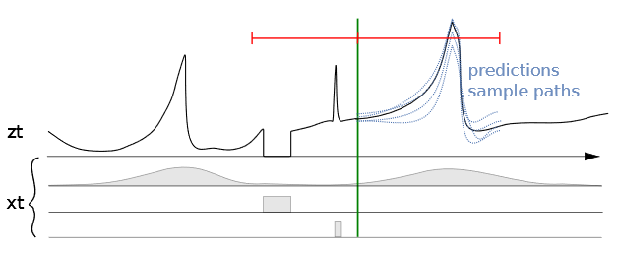
Classic Machine Learning Algorithms
Business/ML Problem
Description
Example
Ranking
Helping users find the most relevant thing
Predicting sales for specific ASINs
Recommendation
Giving users the thing they may be most interested in
Classification
Figuring out what kind of thing something is
Regression
Predicting a numerical value of a thing
Clustering
Putting similar things together
Anomaly Detection
Finding uncommon things
Seasonality | Out of stock | Promotions

Slide 29
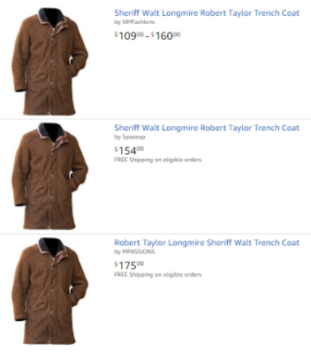
Classic Machine Learning Algorithms
Business/ML Problem
Description
Example
Ranking
Helping users find the most relevant thing
Close-matching for near-duplicates
Recommendation
Giving users the thing they may be most interested in
Classification
Figuring out what kind of thing something is
Regression
Predicting a numerical value of a thing
Clustering
Putting similar things together
Anomaly Detection
Finding uncommon things

Slide 30
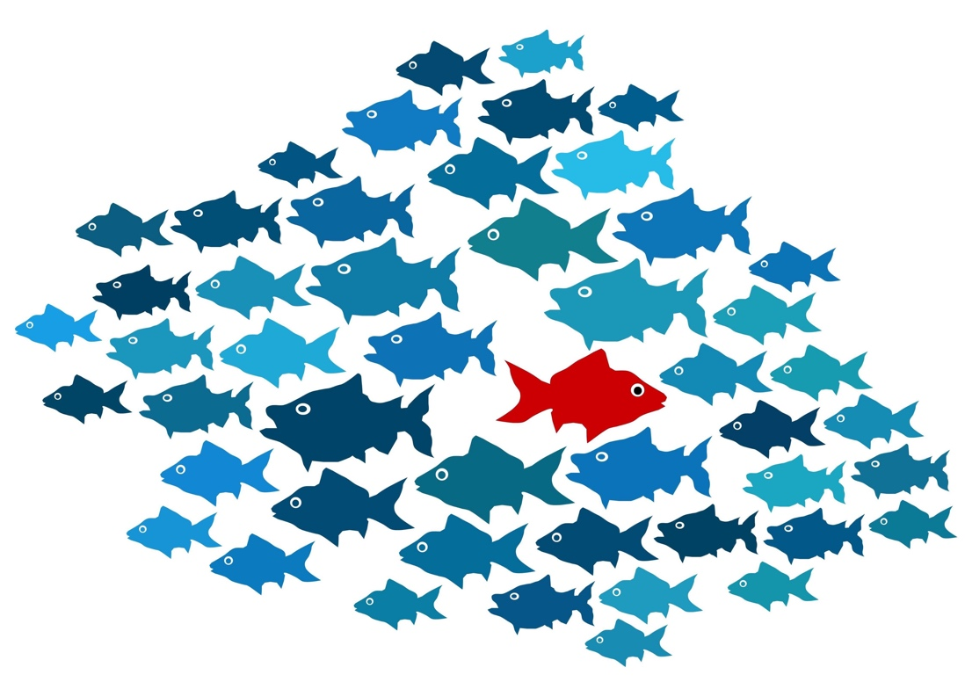
Classic Machine Learning Algorithms
Business/ML Problem
Description
Example
Example
Ranking
Helping users find the most relevant thing
Recommendation
Giving users the thing they may be most interested in
Classification
Figuring out what kind of thing something is
Regression
Predicting a numerical value of a thing
Clustering
Putting similar things together
Anomaly Detection
Finding uncommon things

Slide 31
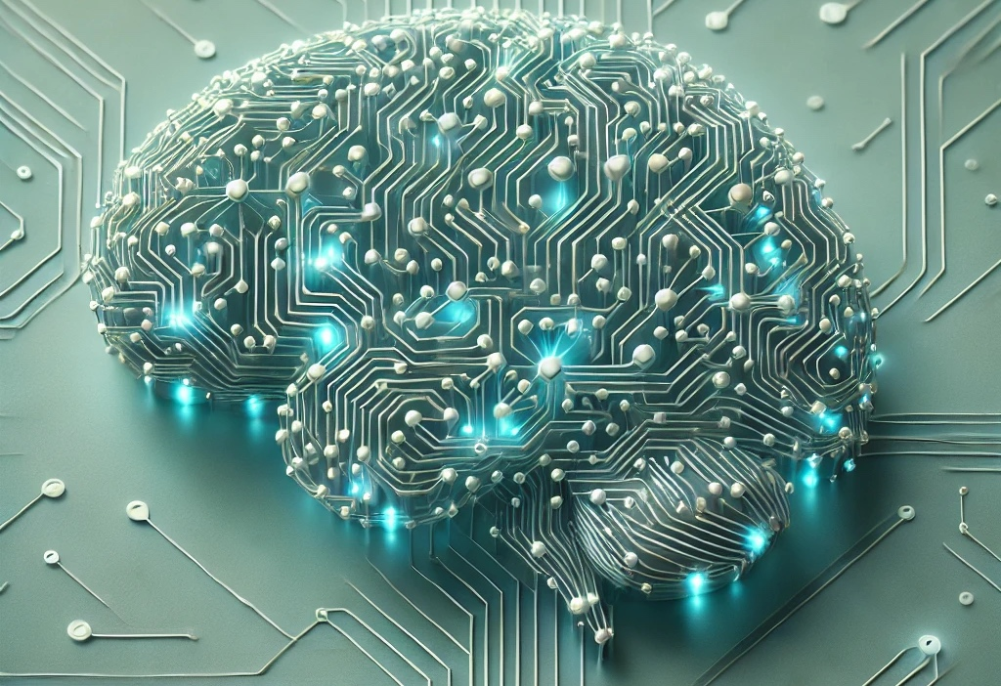
AI = Generation
Text
Images
Sound
Data

Slide 32
Large Language Models (LLM) deal w. text…
Trained on Large Text Datasets: Large Language Models (LLMs) are trained on vast amounts of text from diverse sources. This training process allows them to learn common patterns, contexts, grammar, and relationships between words across a wide range of topics.
Learn Word Sequences and Context: Through this exposure, the model learns how words and phrases typically follow one another in specific contexts. This learning isn’t memorizing sentences but understanding the statistical relationships between words.
Generate Text Based on a Prompt: When given a prompt, the LLM starts with the initial input and predicts the next word based on the patterns it learned during training. It then takes the entire sequence (the prompt plus generated words) and repeats the prediction process, generating one word at a time.
Recursive Prediction: This word-by-word, recursive approach continues until it reaches a specified length or encounters an end condition. Each new word generated is based on the context built from both the prompt and the previously generated words.

Slide 33

What comes after!
THE Word “UNITED”

Slide 34
LLMs are simple-ish… just billions of calculations
“It’s similar to how a person might finish each line in a story based on previous lines they’ve read—predicting the next part based on what would make sense.”
For example: "To be, or not to be, _____” what’s the next word?
That (89%)
What (10%)
How (3%)
An(2%)
Then after “That” what’s the next word?
Is(95%)
Could(3%)
Would(1%)
Should(1%)
And it repeats until it resolves to “That is the Question!”

Slide 35
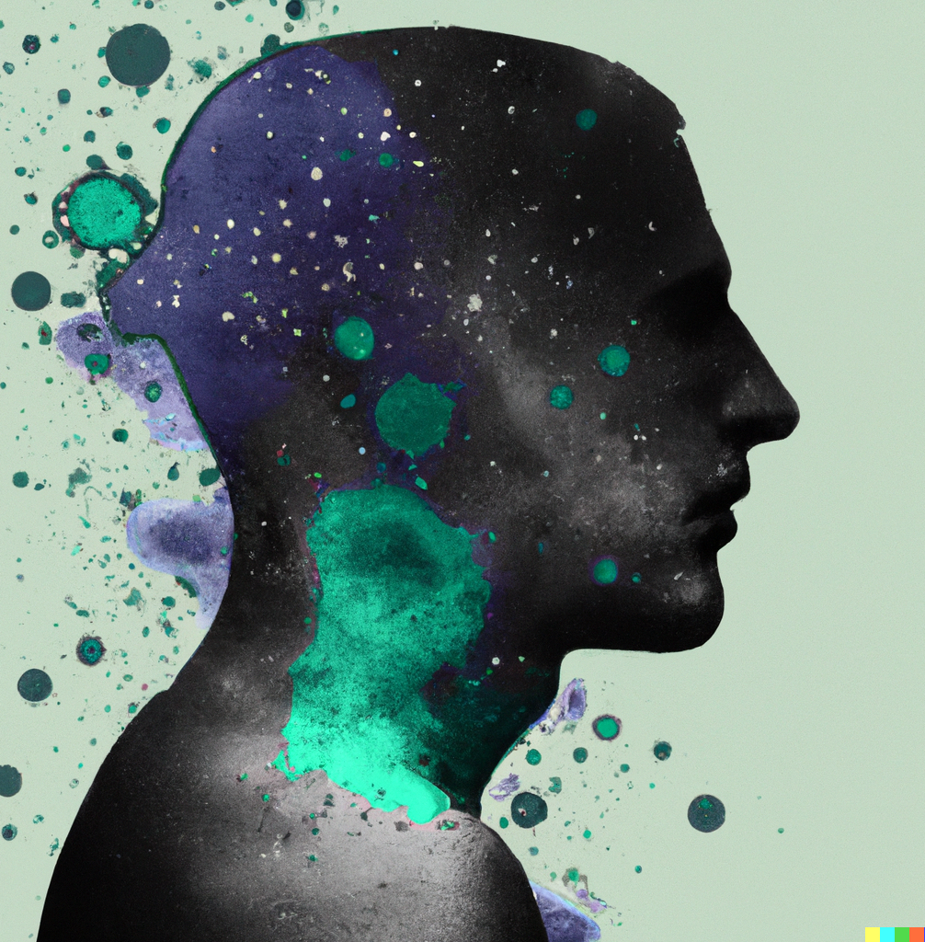
Computer Vision - works similarly..
During training, the model is exposed to millions of images along with text descriptions that explain the content of these images. For instance, if it's training on a dataset of "cats," it learns the shapes, textures, colors, and typical spatial relationships that define a cat.
Based on the prompt, the model synthesizes the image by combining relevant shapes, textures, and colors in a way that matches the description.

Slide 36
AI Cannot Do
True Understanding or Consciousness
Creativity and Original Thought
Moral and Ethical Judgment
Generalization Outside of Training Data

Slide 37
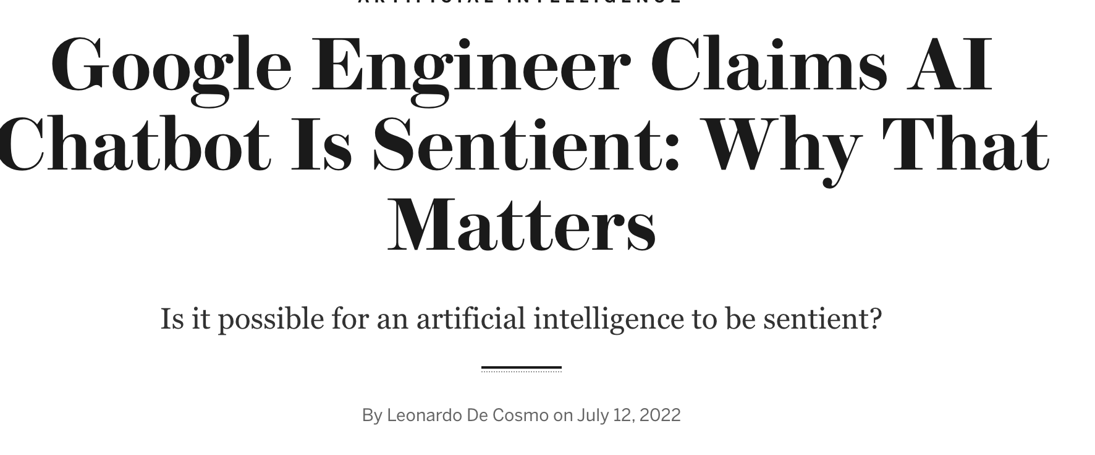
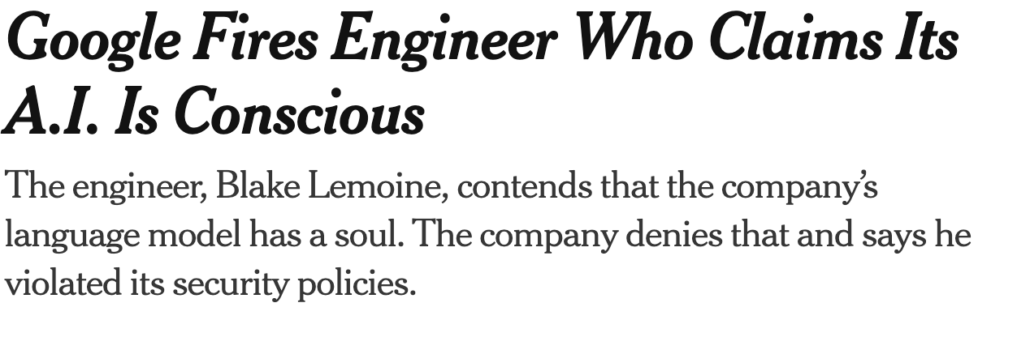
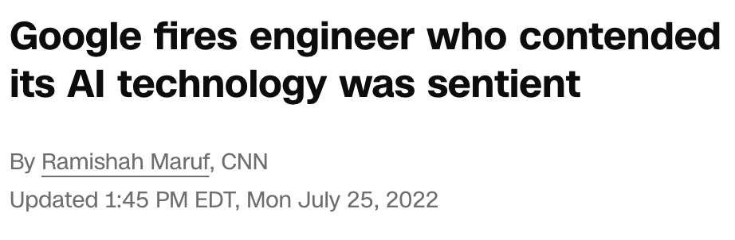
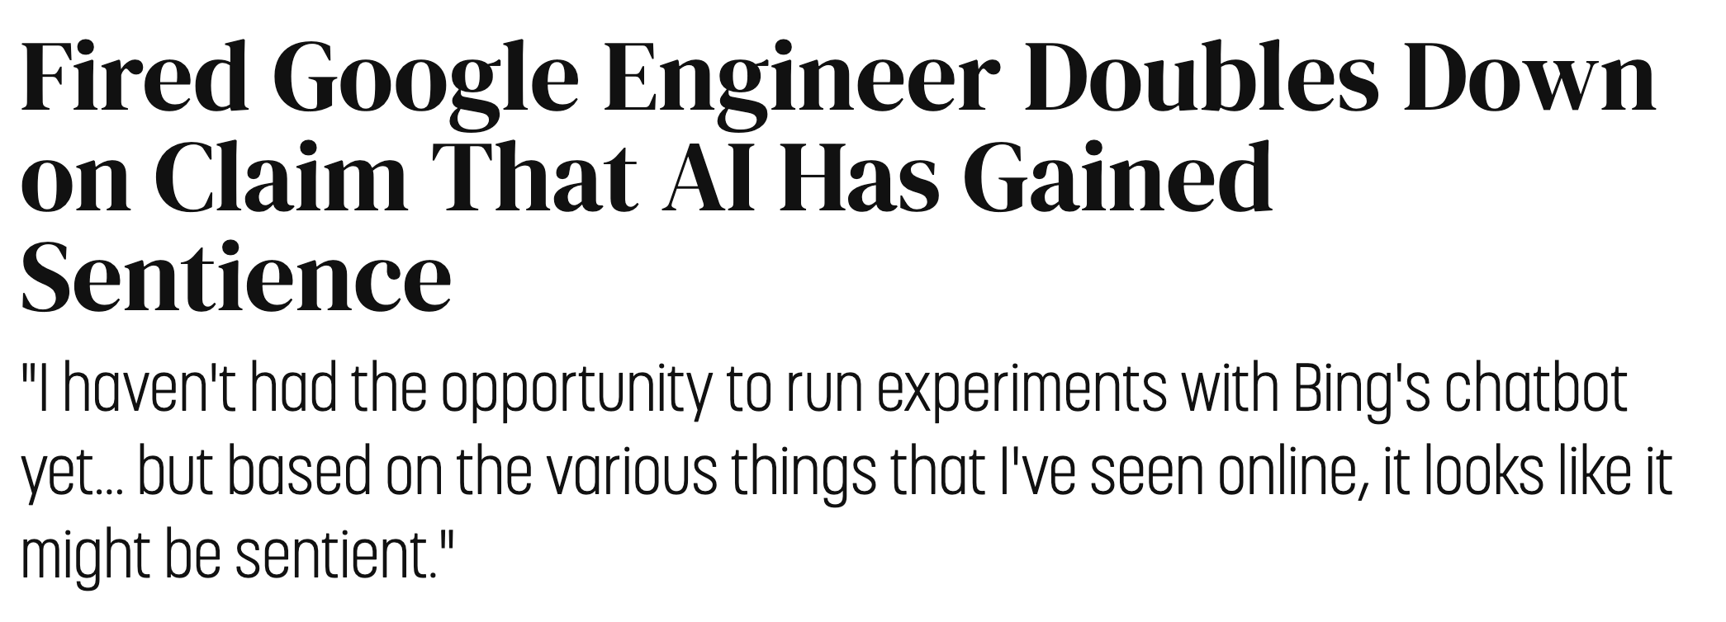
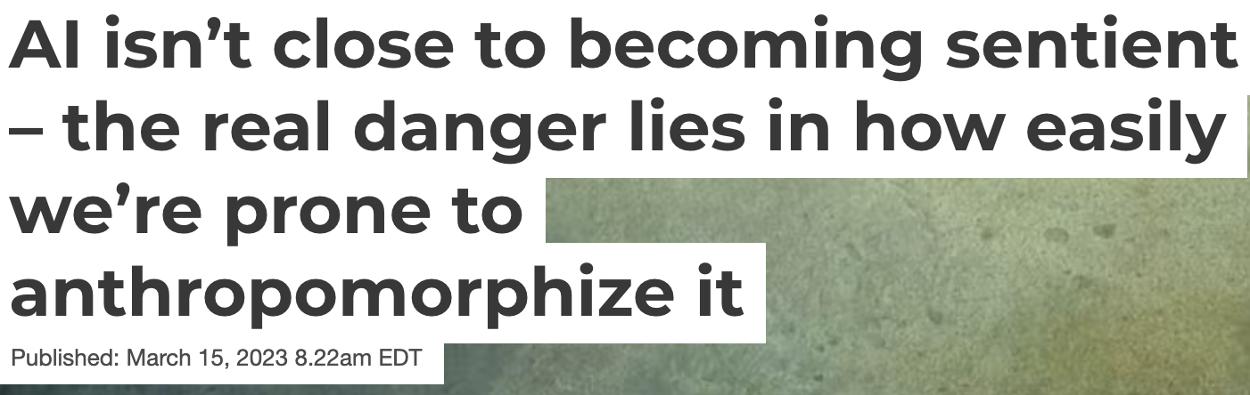
Is AI alive?
Notes:
In the AI age we are anthropomorphizing AI chatbots
AI isn’t alive
It doesn’t …
death comes when you either choose or are incapable of experiencing
AI doesn’t experience.

Slide 38
AI’s Ethical and Social Considerations
Bias: Data bias affecting outcomes.
Example if you only train on English how can you Spanish?
Privacy: Data handling and security.
How is data handled behind the scenes
How to avoid poisoning
Job Displacement: Societal shifts due to automation.
How to retool workforce?
Safety: Risks with autonomous AI.
Why did the AI make this decision, generate this, etc.

Slide 39

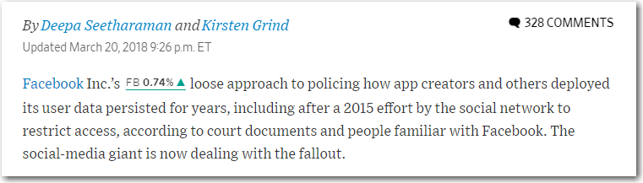
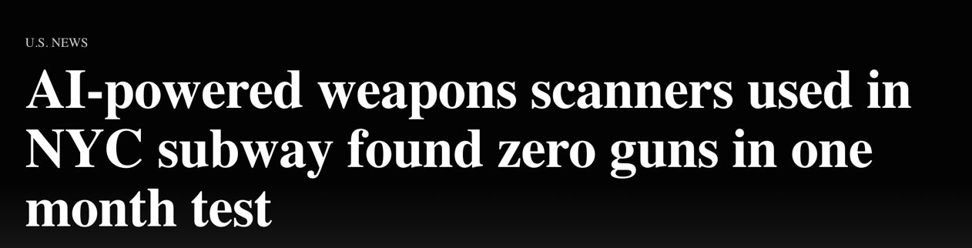


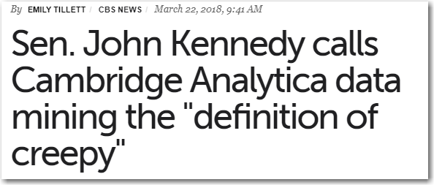
Govern the process…
https://incidentdatabase.ai/
Notes:
None of us want to end up on the front page of the WSJ, without governace that is just what happens.
Data is a shared asset. It is often stated that good fences make good neighbors. This principle applies to data as well. In complex organizations, agreed upon boundaries delineate ownership and areas of responsibility.
Data is consumed by many. For many executives, discussions revolving around data management can seem abstract or arcane. There is general consensus that decision-makers want data that is credible, accurate, reliable, and hopefully predictive and insightful
Data ownership is a responsibility. The data life-cycle process illustrates the various forks along the way where data may be transformed, or where ‘bad data’ may be propagated.
Data is not just for specialists. Like with any specialized field – medicine, military, sports, finance, academia – data is a complex domain that fosters its own specialists with their own jargon – meta-data, master data management, ETL, Hadoop.

Slide 40
AI’s Future
Advancements in AI capabilities like language models – coming fast and furious.
Challenges: Ethical, fairness, transparency – more regulation likely coming to a place near you…
Developments: Potential for General AI, AI integration – where is value going to come from?

Slide 41

Keys to success with AI
Competition drives innovation…
Have capacity to expand on demand…
Experiment relentlessly…
Have a process to go from end to …
Monitor / Evaluate / Govern …
Make it explainable…
Rinse repeat …
“It’s a journey, not a destination”
Notes:
Reach out to our team, we are here to serve the rest of product management not just a handful “It’s a journey, not a destination”

